Slide 1
PM2.5 Personal Exposure Study
Team members in Dhaka University Group:
Atmospheric Chemistry | Health
Abdus Salam | Mahbuba Yesmin
Shatabdi Roy | Farah Jeba
Md. Asif Iqbal Nayeem | Shahid Uz Zaman Adil

Slide 2
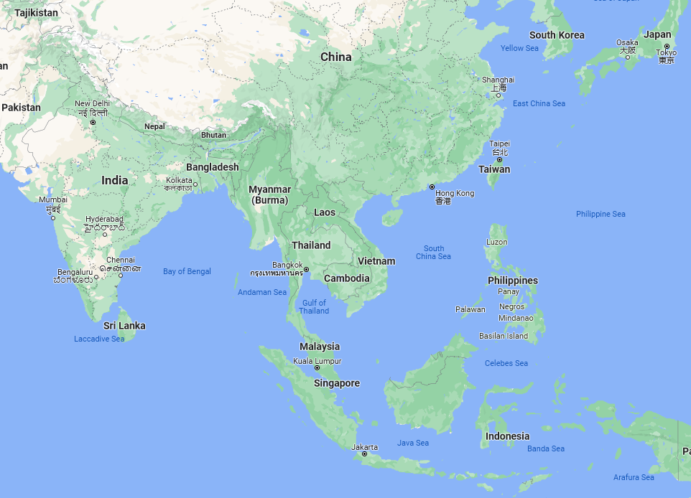
Participating Groups involved in this PM2.5 Exposure study
Kuala Lumpur, Malaysia
Taipei, Taiwan
Dhaka, Bangladesh
Any other locations/Group are most welcome to join.

Slide 3
Scientific Questions: Understanding the impact of fine particles exposure on human health
Objectives:
- What are the Emission sources?
-What kind of changes will be observed in personal health parameters.
Study design: Need As-Lung sensor, one person or group of people can be a subject.
Data availability: Three (Dhaka, Taipei and Kuala Lumpur) groups already have data. If data is available that's fine. If not, then you can still participate and also collect data latter on.

Slide 4
Writing manuscript:
We can take an example from Prof. Kim – Thanks to Kim for her great lead and role.

Slide 5
Sensors Calibration were done between As Lung and TSI Blue Sky – Dr. Candice lead
- Both sensors were running side by side for 10 days at both ambient and at also very high PM2.5 generated by KEROSINE burner
Personal Exposure study were done with As Lung Sensors for ten days continuously at different situations/activity in Dhaka city – Myself lead
Emission from Cooking stoves were done at relatively low income generating homes for 7 days – Prof Kim lead

